Slide 1
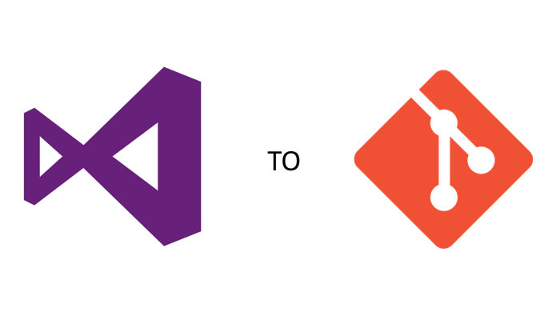
Transitioning from TFS to GitLab
4 Days workshop By: Kusai Esseid

Slide 2

ABOUT THE TRAINER
KUSAI MOSBAH ESSEID
Senior DevOps Engineer
qosaiassiad@gmail.com
+601123408314
https://www.linkedin.com/in/kusaiesseid/

Slide 3
Trainer Profile: Kusai Mosbah Esseid
Kusai is an IT professional with a strong academic and professional background in Information Technology and Cloud Computing. He holds a Bachelor's Degree in Information Technology (2014–2017) with a GPA of 3.4, followed by a Master's Degree in Information Technology (2018–2019) where he graduated with a GPA of 3.87 and received the Best Student Award. Currently, he is pursuing a PhD in Computer Science, focusing on Online News Recommendation using Deep Learning, demonstrating his continuous pursuit of innovation and technical excellence.
Professionally, Kusai has developed extensive experience in DevOps, Cloud Infrastructure, and Security Operations through his work at Ørsted, a global leader in renewable energy. As part of the Engineering Cloud System Team, he contributes to the organization’s multi-cloud transformation, leading initiatives that span automation, governance, and platform reliability across Azure and AWS. He plays a key role in migrating workloads from Azure DevOps and AKS to GitHub Actions and AWS EKS, implementing Infrastructure as Code (Terraform), Kubernetes cluster lifecycle management, and secure CI/CD automation. Kusai also drives Velero-based backup strategies, KEDA auto-scaling configurations, and JFrog Artifactory governance, ensuring operational excellence, compliance, and resilience across environments.
Kusai is fluent in Arabic and English, enhancing his ability to communicate effectively with diverse global teams. His technical credentials include Certified Kubernetes Administrator (CKA), Alibaba Cloud Professional (Cloud Computing & Security), Microsoft Azure Fundamentals, ITIL 4, and Certified Trainer (TTT) — reflecting his depth in cloud infrastructure, DevOps automation, and IT service management.
His career journey includes roles such as Linux System Administrator at ITRANSCEND (M) SDN BHD, Cloud Computing Architect at ARINAA KAMBYAN BERHAD, and System Administrator at AppAsia Tech Sdn Bhd. Currently, he serves as Cloud Manager at AIA Digital+ in Kuala Lumpur, overseeing cloud-native operations and managing Azure Kubernetes Service (AKS) for multiple business units.
Kusai’s skills span Cloud Computing, DevOps Automation, Kubernetes and Linux Administration, GitLab, GitHub, Network Security, Firewall and FortiGate Management, Virtualization (Proxmox, VMware, KVM), Database and Web Server Administration, and Technical Training. His blend of deep technical expertise and real-world DevOps experience enables him to design, secure, and optimize cloud-native environments while mentoring teams to adopt best practices in automation and governance.

Slide 4

Class Material
https://tinyurl.com/tfs-git

Slide 5
Agenda
Day 1: From TFS to GitLab: Foundations
Understanding the Shift, Git & GitLab Basics, Hands-on Lab
Day 2: Collaboration & Code Quality in .NET Projects
Collaboration, Traceability, Code Quality, Hands-on Lab
Day 3: CI/CD for .NET in GitLab
Pipelines, Delivery Efficiency, Rollback, Hands-on Lab
Day 4: Standardized Practices & Developer Autonomy
Standardization, Empowering Developers, Capstone Simulation, Wrap-Up

Slide 6
Workshop Objectives
By the end of this course, participants will be able to:
Successfully migrate TFS projects into GitLab repositories.
Manage .NET solution files and dependencies under Git branching workflows.
Use GitLab CI/CD to build and test .NET Core/.NET Framework projects automatically.
Replace TFS Build/Release pipelines with GitLab pipelines.
Integrate quality gates such as SonarQube, NUnit, and code coverage tools into GitLab CI.
Confidently debug and fix issues in Git pipelines without relying on legacy TFS tools.

Slide 7


Slide 8

From TFS to GitLab: Foundations
Understanding the Shift, Git & GitLab Basics, Hands-on Lab

Slide 9
How TFS (TFVC) Differs From Git
Centralized Version Control (TFS/TFVC)
One central server stores all versions
Developers depend on server availability
Check-in / check-out workflow
Weak offline support
Branching is heavy and slow
Changes are serialized (historically locking-based model)

Slide 10
How TFS (TFVC) Differs From Git
Distributed Version Control (Git)
Every developer has a full local repository
Commits & operations are local (faster)
Offline work is fully supported
Branching is lightweight and encouraged
Push/pull for collaboration instead of check-in

Slide 11
TFS vs Git
Area | TFS (Centralized) | Git (Distributed)
Architecture | Single central repo | Local repo per developer
Offline Work | Very limited | Full offline workflow
Branching | Expensive, avoided | Cheap, used frequently
Merging | Hard, error-prone | Optimized for merging
Speed | Dependent on server | Local operations = very fast
Collaboration | Check-in policies, locking | Merge Requests, branching model
History | Stored only on server | Each user has full history
Suitable For | Monolithic legacy apps | Modern DevOps, microservices

Slide 12
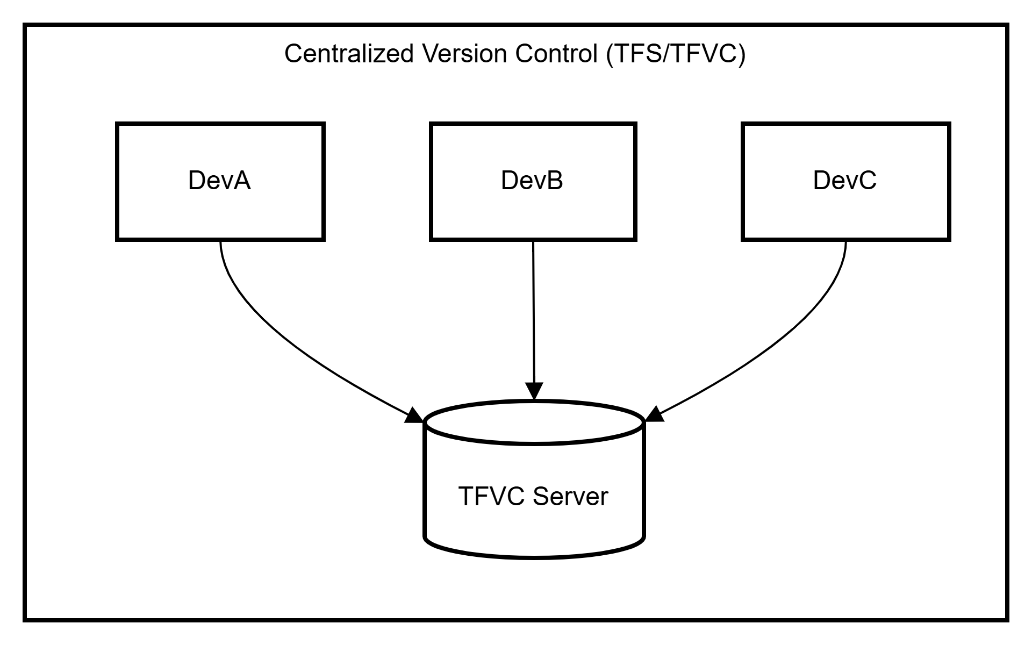
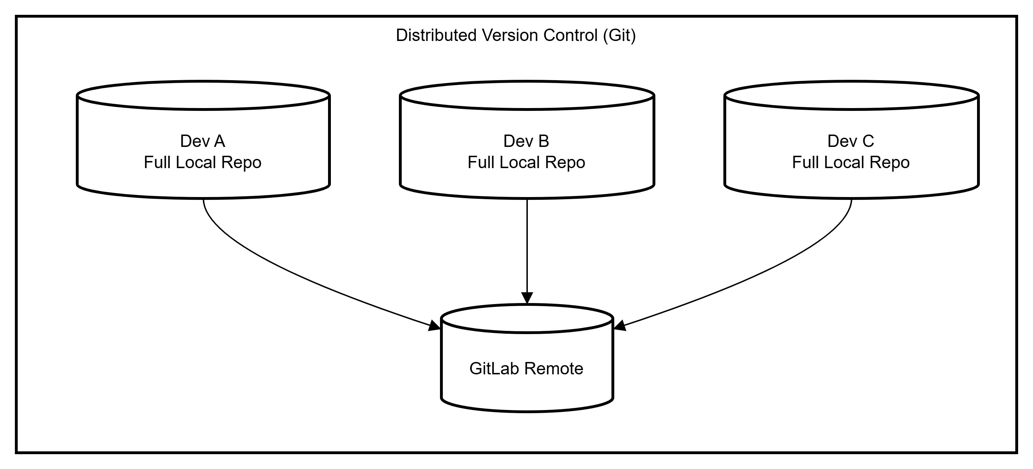

Slide 13
Why the Architecture Matters
Impact of Centralized (TFS)
Slow operations (server round-trips)
Merging becomes bottleneck
Branches avoided → larger changes → more conflicts
No autonomy when offline
Hard to scale for modern DevOps
Impact of Distributed (Git)
Developers make progress anytime (offline supported)
Fast commits, fast diffs, fast merges
Small branches → clean change history
Enables GitLab CI/CD for every branch
Better collaboration & traceability

Slide 14
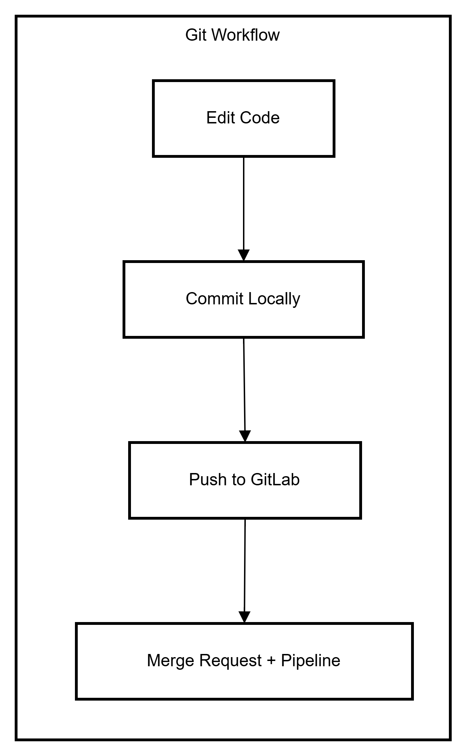
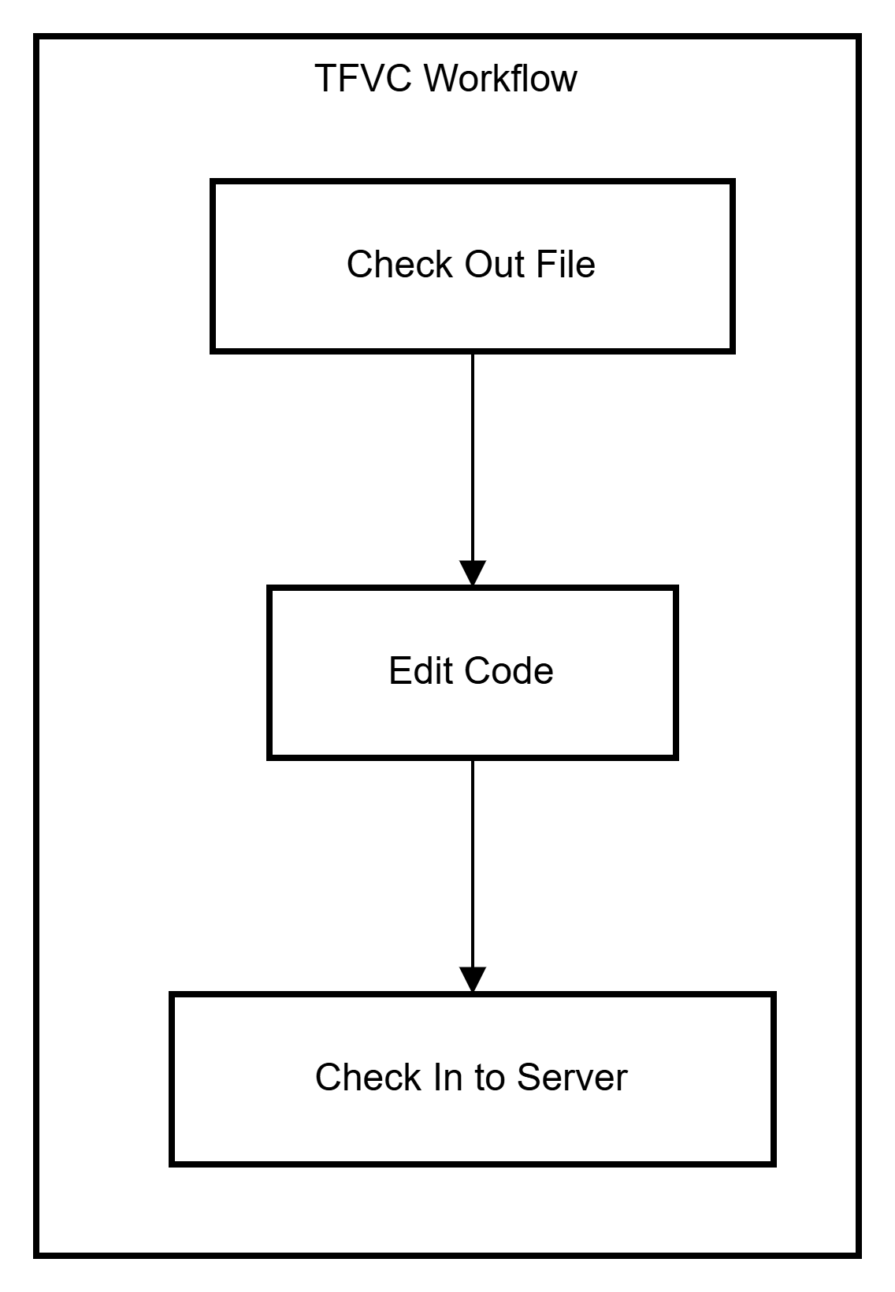
Workflow Differences (.NET Developer View)

Slide 15
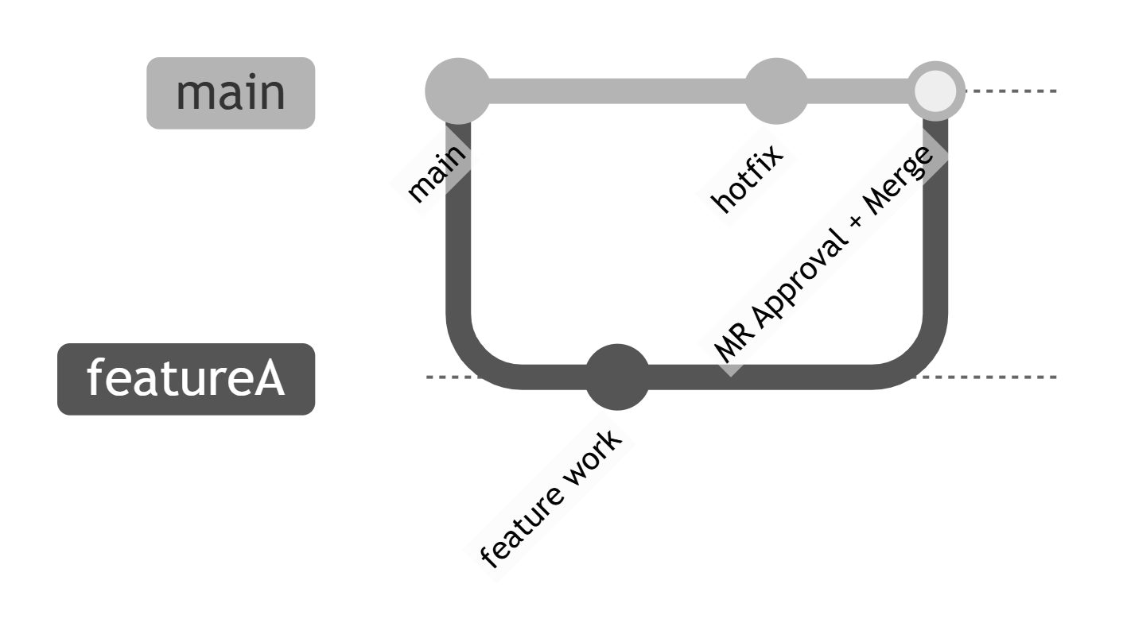
Branching

Slide 16
What Changes for Teams Migrating from TFS
What stays the same
You still edit code in Visual Studio
You still commit changes
You still have branches
What improves drastically
Local commits = faster & safer
Conflicts resolved earlier, not at release time
CI/CD runs on every branch automatically
Pull Requests (MRs) enforce quality
Traceability: commits → issues → pipelines → artifacts
New mindset
Think in small units of work
Commit locally often
Create branches freely
Use MR as your “check-in policy replacement”

Slide 17
Migration Considerations Overview
Before migrating from TFS → GitLab, three areas must be addressed:
History: Do we migrate all changesets or just the latest snapshot?
Permissions: TFS folder-based security must be mapped to GitLab project/branch-based permissions.
Branch Structures: TFVC’s long-lived branches don’t map 1:1 to Git; we must redesign branching strategy.
Key Message:
Migration is not a “copy–paste” of source code — it is a workflow transformation.

Slide 18
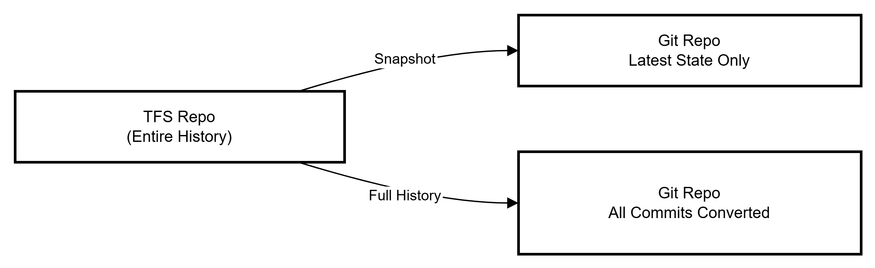
History Considerations
Two migration approaches:
1. Snapshot Migration (recommended)
Only migrate the latest version of the code
Clean start → no baggage
Great for modernizing branching & pipelines
Easiest to automate
2. Full History Migration
Converts TFS changesets → Git commits
Useful only if compliance or audits require full history
Slower, risk of corrupt paths, large repo size

Slide 19
Permissions Considerations
TFS permission model ≠ GitLab permission model.
TFS Permissions
Folder-level security
Check-in permissions
Locking / exclusive checkout
GitLab Permissions
No folder-level security
Access is granted at project or group level
Fine control via:
Branch protection
Who can push
Who can merge
Required approvals
Pipeline requirements

Slide 20
Mapping Approach
TFS Role | GitLab Equivalent
Reader | Reporter
Contributor | Developer
Lead / Senior Dev | Maintainer
Admin | Owner

Slide 21
Branch Structure Considerations
Typical TFVC branching
Main, Dev branch, Feature branches rarely used, Release branches created late, Heavy merges
Git branching philosophy
Small, short-lived feature branches
Merge Requests (MR) enforce review
Clear separation:
main → stable
develop (optional)
feature/
hotfix/
release/

Slide 22
Branch Structure Considerations
Actions during migration
Identify old TFVC branches
Keep only meaningful ones
Decide on GitLab Flow or GitFlow
Rebuild branches in Git, not replicate old TFVC structure as-is

Slide 23
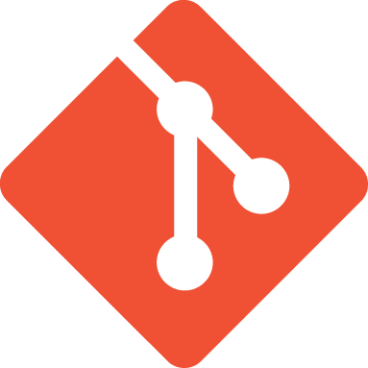
Git &GitLab
Git – is a source code versioning system that lets locally track changes and push or pull changes from remote resources.
A Git repository tracks and saves the history of all changes made to the files in a Git project.
Allow you to know who made what changes and when.
Allow you to revert any changes and go back to a previous state.
Allow for collaborative development.
https://git-scm.com

Slide 24
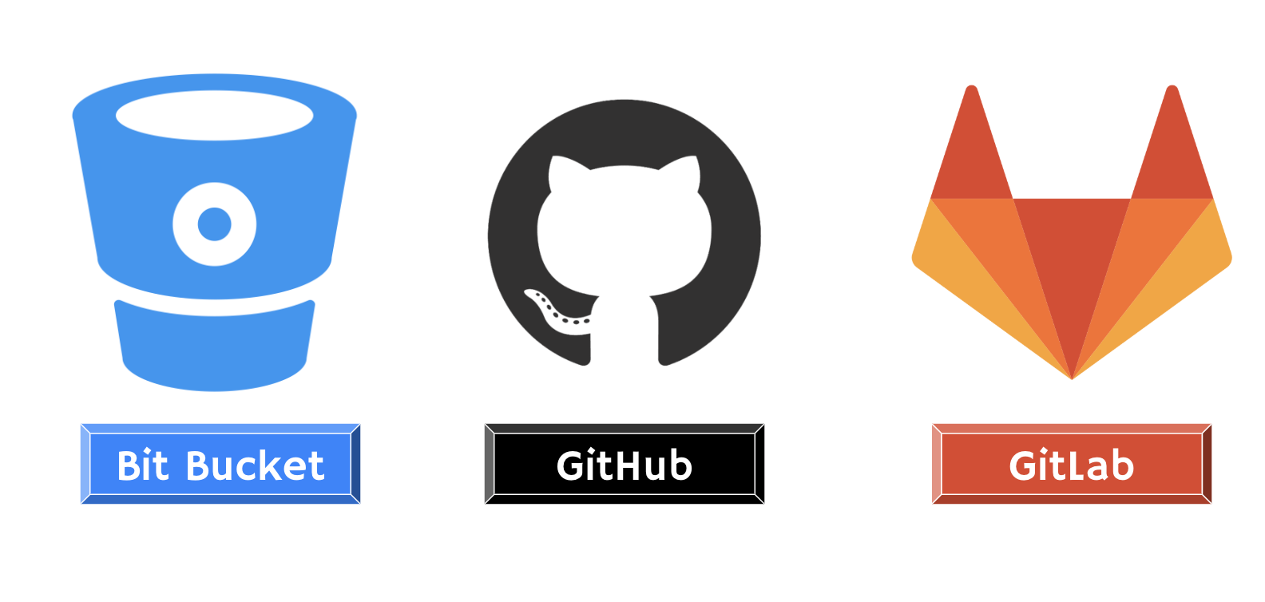
GitLab, GitHub, and Bitbucket – are services that provide remote access to Git repositories.

Slide 25

What is GitLab?
GitLab is a complete DevOps platform built around Git.
Enables teams to collaborate on code, build CI/CD pipelines, track issues, and manage deployments in one application.
Supports both cloud-hosted (GitLab.com) and self-managed installations.
Note: GitLab ≠ Git — GitLab uses Git under the hood.

Slide 26
Git vs GitLab
Git | GitLab
Tracks code changes locally | A cloud platform for teams using Git
Command-line tool | Web-based (with Git support)
You work on your laptop | You push/pull your work to/from GitLab
No UI | Has full UI, CI/CD, issues, merge reqs

Slide 27
Year | Milestone
2011 | Created by Dmitriy Zaporozhets as an open-source Git repository manager
2013 | GitLab Inc. founded by Sid Sijbrandij to commercialize the platform
2015 | CI integrated into GitLab — marked the beginning of the single DevOps platform vision
2017 | Auto DevOps introduced with initial Kubernetes integration
2018 | Launched GitLab Ultimate with enhanced security and compliance features
2021 | GitLab went public on NASDAQ under the ticker GTLB
2023+ | Added AI-powered DevSecOps, expanded remote-first culture, and achieved global scale

Slide 28
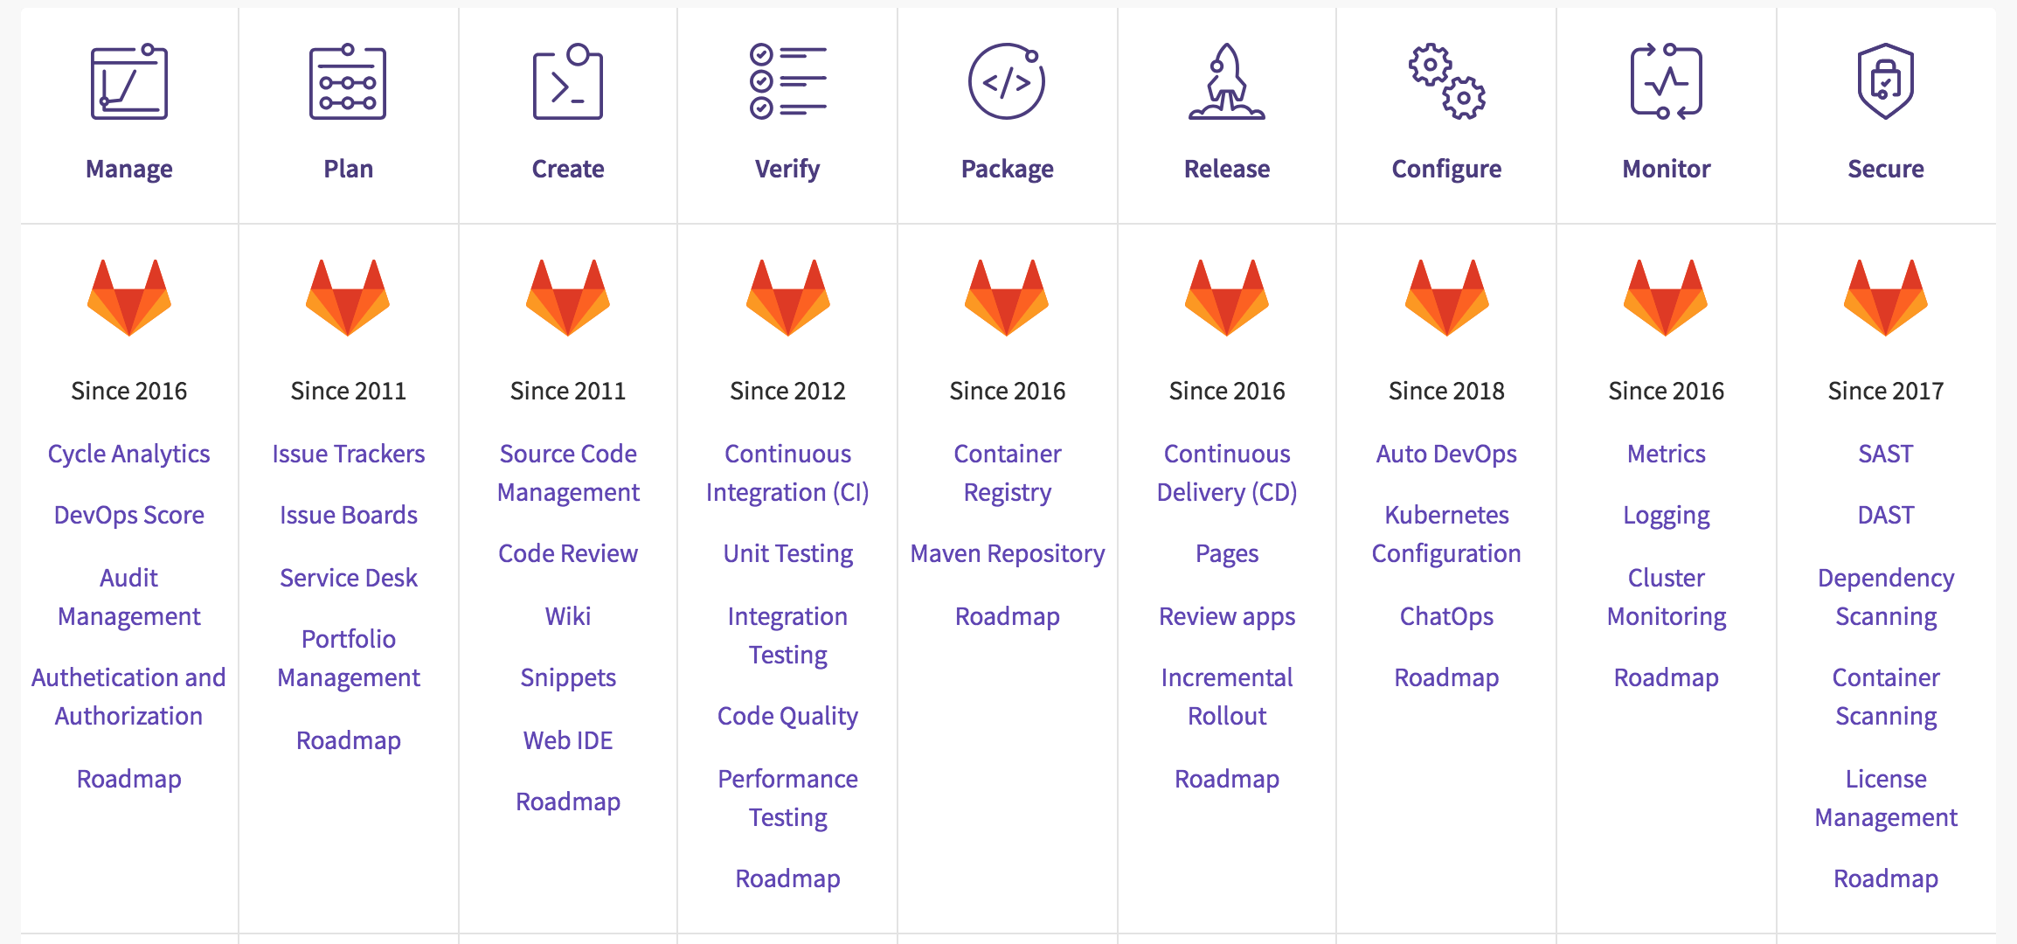
A single application for the entire DevOps lifecycle

Slide 29
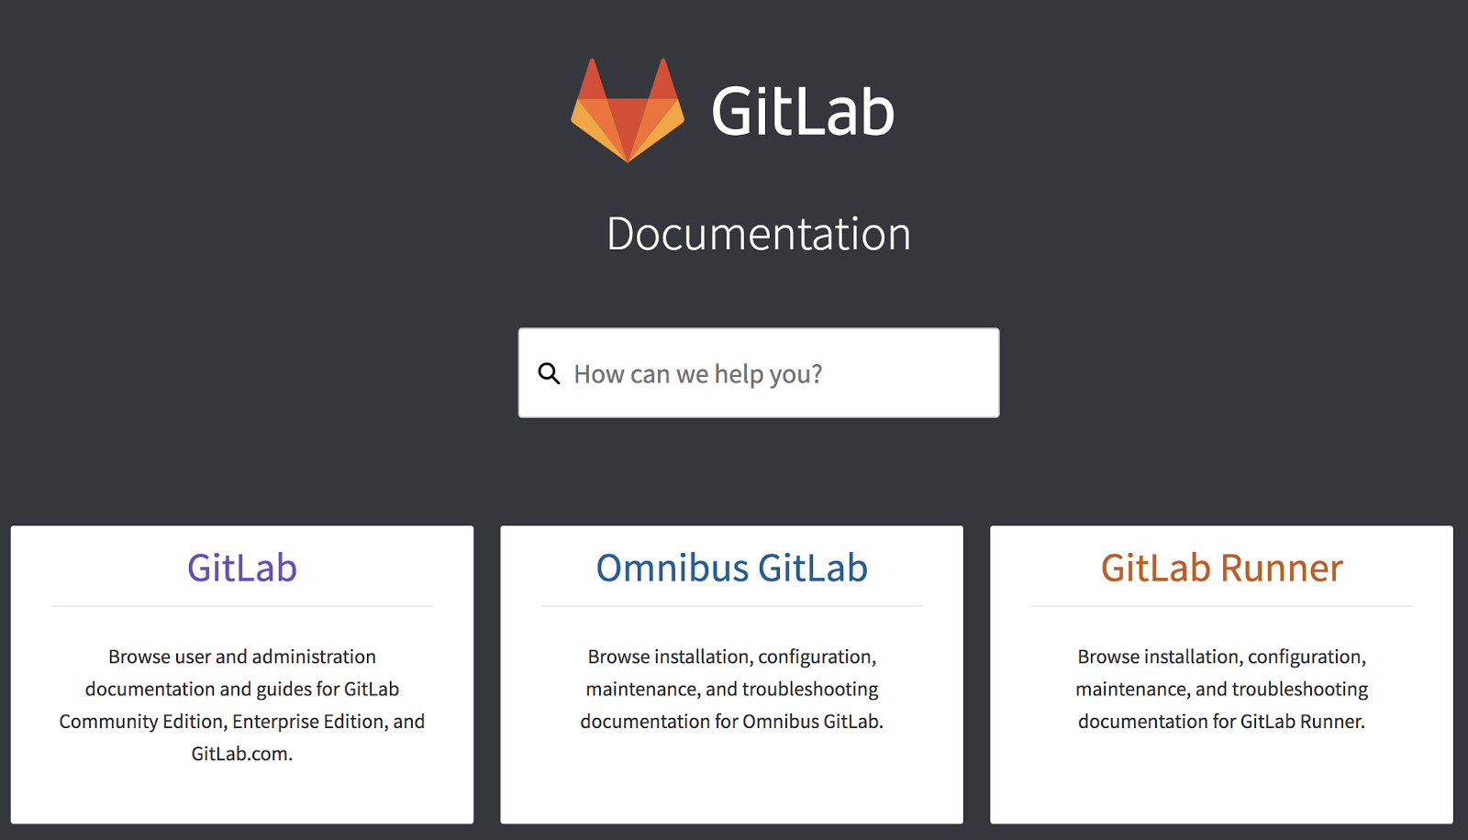
GitLab Documentation
docs.gitlab.com

Slide 30
GitLab Cloud vs Self-Managed
Feature | GitLab Cloud (GitLab.com) | GitLab Self-Managed
Hosting | Managed by GitLab Inc. | You manage on-prem or cloud
Maintenance | Handled by GitLab | Your responsibility
Customization | Limited | Full control
Infrastructure Cost | None | Your infrastructure
Setup Time | Instant | Medium to High
Use Case | Startups, SMBs | Enterprises, regulated orgs

Slide 31
GitLab vs GitHub vs Bitbucket
Feature | GitLab | GitHub | Bitbucket
CI/CD | ✅ Built-in | ✅ GitHub Actions | ✅ Pipelines
Self-hosted Option | ✅ Yes | ⚠️ Limited (GH Enterprise) | ✅ Yes
DevOps Lifecycle | ✅ Full stack | ❌ Partial | ❌ Partial
Permissions | Fine-grained | Good | Good
Boards & Issues | ✅ Advanced | ✅ Basic | ✅ Good
Used by | Enterprises, DevOps | Open source, community | Atlassian shops
Notes:
Note: GitLab is strong in CI/CD and complete DevOps, GitHub leads in community and open source, Bitbucket fits well with Jira/Atlassian users.

Slide 32
Key GitLab Features
Developer Tools
Full Git repository management
Merge Requests (MRs) with code reviews
Built-in Web IDE for editing code directly in the browser
CI/CD Capabilities
Native support for Continuous Integration and Deployment
Easy-to-use .gitlab-ci.yml configuration file
Pipeline visualization and multi-stage jobs
GitLab Runners for automation

Slide 33
Project Management
Issue tracking system with labels, assignees, and due dates
Agile boards for visualizing work (Kanban-style)
Milestones, epics, and roadmaps for planning
Security & Compliance
Static Application Security Testing (SAST)
Dynamic Application Security Testing (DAST)
Dependency scanning and secret detection
Built-in compliance reporting
DevOps Integrations
Seamless Kubernetes integration
Package registries (Docker, Maven, NPM)
Integrates with tools like Slack, Opsgenie, Prometheus, and more

Slide 34
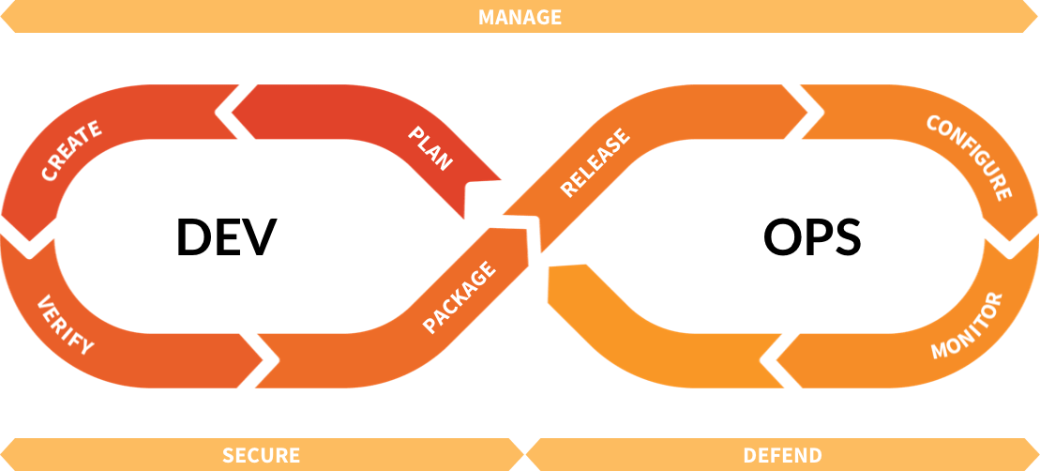
GitLab in the DevOps Lifecycle
Plan → Code → Build → Test → Release → Deploy → Monitor → Secure
GitLab supports the entire DevOps lifecycle in one tool, with seamless handoff between stages.

Slide 35

Lab 1

Slide 36
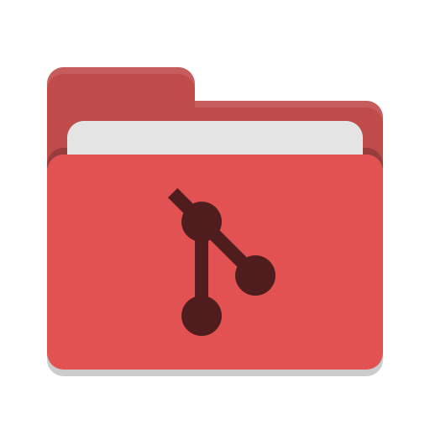
Git & Repository Management
Working with Git in GitLab and Following Modern Team Practices

Slide 37
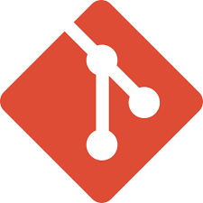
Key Git terms
Local Repo | Local copy of the upstream repo
Remote (Upstream repo) | Hosted repository on a shared server (GitLab)
Untracked files | New files that Git has not been told to track previously
Working area | Files that have been modified but not committed
Staging area | Modified/Added files that are marked to go into the next commit

Slide 38
Key Git terms (cont.)
Branch | Independent line of development (typically scoped to a feature or bug fix)
Main (or master) Branch (trunk) | The canonical branch for the repository
Fork | A person copy of the ENTIRE repository
Merge | Bring two branches together

Slide 39
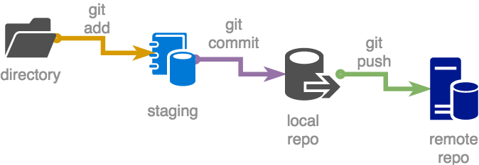
Local Repo consists of three trees
A Working Directory with the actual files,
the Staging Area and
the last commit you made which is called HEAD

Slide 40

Let's put it all together!

Slide 41
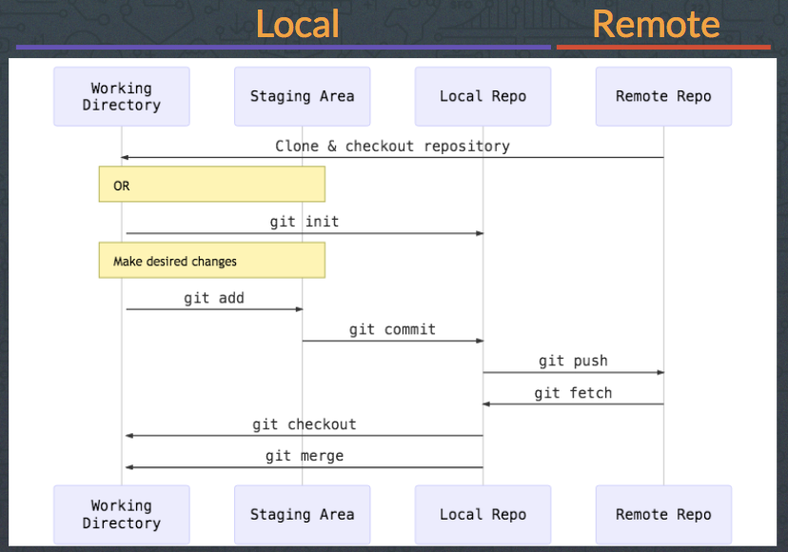
Basic Git Workflow

Slide 42
Basic Git Workflow (Cont.)
Core Git Commands for Daily Use:
git clone <repo-url> – Copy a remote repository to your local machine
git add <file> – Stage file changes
git commit -m "message" – Save staged changes locally
git push – Upload local changes to the remote repository
git pull – Fetch and merge changes from remote into local
git branch <name> – Create a new branch
git checkout <name> – Switch between branches

Slide 43


Slide 44
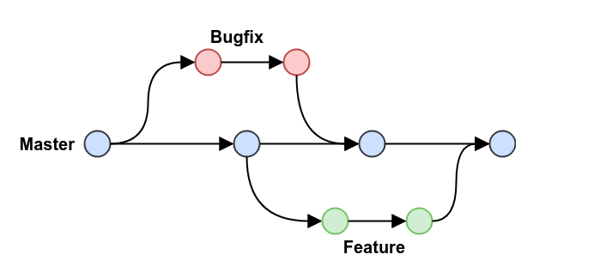
Git Branching Strategies
Why Branching Matters:
Isolate features, bug fixes, and experiments
Support parallel development
Prevent instability in the main codebase

Slide 45
Git Branching Strategies (Cont.)
Common Branching Models:
Choose the strategy based on your team size and deployment frequency.
Strategy | Description
Feature Branch | Each feature or fix has its own branch, merged when complete
Git Flow | Structured model with main, develop, feature/*, release/*, hotfix/* branches
Trunk-Based | Short-lived branches, frequent merges to main, fast delivery model

Slide 46
Merge Requests (MRs) and Code Reviews
A Merge Request (MR) in GitLab is a way to propose changes from one branch to another.
It allows developers to:
Compare code differences
Discuss changes with teammates
Run automated CI/CD pipelines
Get approvals before merging into protected branches (e.g., main or develop)

Slide 47
Key Components of an MR
Source branch: where changes are made (e.g., feature/login)
Target branch: usually main, develop, or a release branch
Title & Description: explain what the MR does
Assignees & Reviewers: people responsible for reviewing or approving the MR
Approvals & Comments: inline code discussions and change suggestions
Pipeline Status shows if CI jobs (tests, builds) have passed
Merge Conditions: e.g., "only allow merge if pipeline passes and 1 approval received"

Slide 48
Benefits of Code Reviews via MRs
Catch bugs early before they reach production
Improve code quality and consistency
Promote shared understanding and team learning
Enable compliance with security and workflow standards

Slide 49
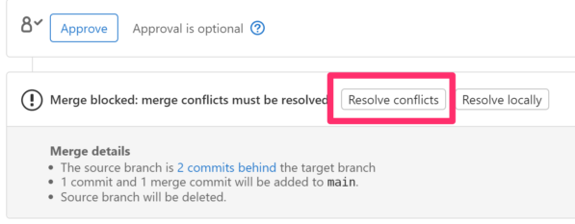
Merge Conflicts
Conflicts happen frequently - if you don’t merge often enough
Try to stay up-to-date with master
Learning to fix merge conflicts can be difficult
Be careful about force pushing after fixing conflicts

Slide 50
Best Practices for MRs
Keep MRs small and focused
Write clear MR titles and descriptions
Tag the right reviewers
Address review comments promptly
Use GitLab’s "suggest changes" for cleaner collaboration

Slide 51
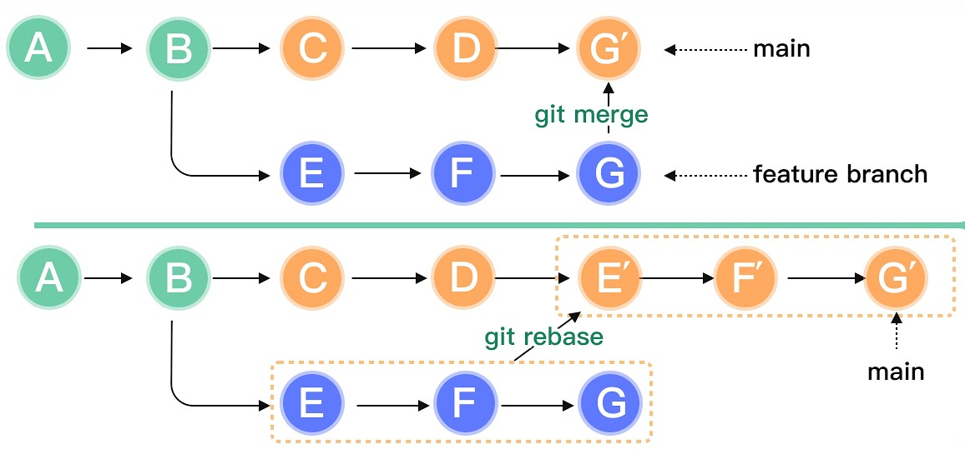
Rebasing vs. Merging
Rebase when updating your branch from master
Merge when bringing changes from feature branch into master

Slide 52
GitLab Project & Access Management
Organizing Projects, Managing Users, and Enabling Integrations

Slide 53
Creating Groups, Projects, and Repositories
Groups
A group is a top-level container that holds projects and subgroups.
Useful for team or department organization.
Permissions and settings can be inherited by all contained projects.
Projects
A project is a single Git repository with built-in issue tracking, CI/CD, wikis, and more.
Projects live inside groups or under personal namespaces.
Repositories
Git repositories store your code, tracked by Git versioning.
Each project in GitLab is backed by a Git repository.

Slide 54
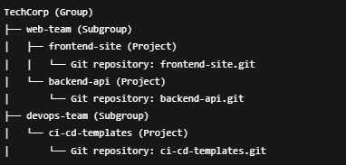
Cont.
Example Structure:

Slide 55
User Roles and Access Levels
GitLab provides five default roles:
Role | Permissions Summary
Guest | View-only access to issues, public repo files
Reporter | Can view and download code, see pipelines, read-only access
Developer | Push to branches, create MRs, run pipelines
Maintainer | Merge code, manage issues, runners, and project settings
Owner | (Group-level only) Manage everything, including members/roles
Best Practice: Use least-privilege principle: assign only the access level needed.

Slide 56
Public vs Private Projects
Project Visibility | Who Can View / Access?
Private | Only invited members
Internal (Self-Managed only) | Any logged-in GitLab user (not available on GitLab.com)
Public | Anyone can view project contents without authentication
Note: Even public projects can have private CI/CD variables or protected branches.

Slide 57
Webhooks and Integrations
What are Webhooks?
A way to automatically send HTTP POST requests when certain events happen in your project.
Examples: Push events, merge requests, pipeline status changes
Common Use Case:
Notify Slack/Teams when:
A new commit is pushed
A merge request is opened
A pipeline fails

Slide 58
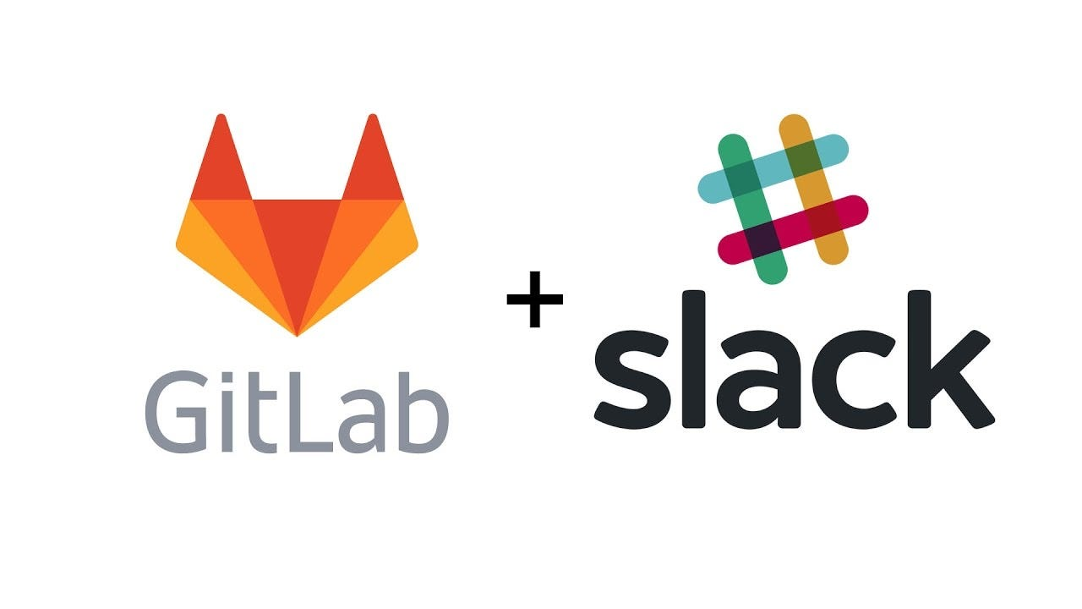
Integrating with Slack (Example)
Go to Project > Settings > Integrations
Select Slack Notifications
Enter your Slack Webhook URL and channel
Choose events to trigger (e.g., push, MR, pipeline fail)
Save
Other Integration Options:
Microsoft Teams, Opsgenie, Jira, GitLab Webhooks with Jenkins or other CI tools

Slide 59
Summary
Groups organize related projects and control access.
Assign roles carefully using GitLab’s permission model.
Control visibility with private or public project settings.
Use webhooks and built-in integrations to automate notifications and workflow triggers.

Slide 60


Slide 61

Understanding GitLab CI/CD
Automating Software Delivery with Pipelines

Slide 62
What is GitLab CI/CD?
GitLab CI/CD is GitLab’s built-in Continuous Integration and Continuous Deployment system that automates the process of building, testing, and deploying code.
Key Features:
Integrated directly into every GitLab project
Triggered automatically by Git events (e.g., push, merge)
Fully customizable with .gitlab-ci.yml
Supports Docker, shell, Kubernetes runners, etc.
Benefits:
Detect bugs early, Enforce consistent workflows, Automate deployments, Increase developer productivity

Slide 63
How GitLab CI/CD Works
Workflow:
Developer pushes code to GitLab
GitLab checks for a .gitlab-ci.yml file in the project root
Pipelines defined in the YAML file are triggered automatically
CI jobs (build/test/deploy) are run using GitLab Runners

Slide 64
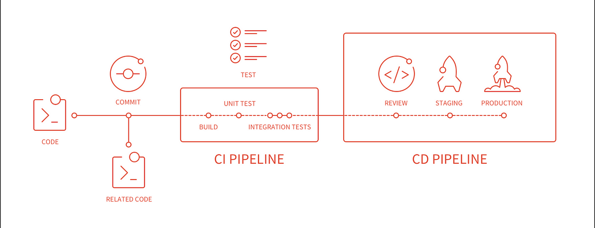

Slide 65
Cont.
Terms to Know:
Pipeline: A sequence of stages/jobs
Job: A single task (e.g., run tests, build app)
Runner: An agent that executes jobs

Slide 66
The .gitlab-ci.yml File
Purpose:
Defines CI/CD workflow and instructions for GitLab to follow when a pipeline runs.
Key Sections:
stages: Declares the pipeline steps (build, test, deploy)
jobs: Scripts tied to stages (e.g., build-app, run-tests)

Slide 67
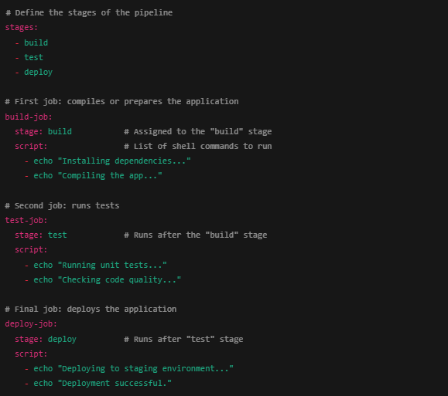

Slide 68
Understanding Pipeline Stages
Stages define the flow of your pipeline:
Stage | Purpose | Example Tasks
Build | Compile and package the code | Install dependencies, compile
Test | Verify the functionality | Run unit/integration tests
Deploy | Ship to staging/production | Upload to server, trigger Helm
Rules:
Jobs in the same stage run in parallel
Stages run in sequence
Best Practice: Keep stages small and focused.

Slide 69
Summary
GitLab CI/CD automates the software lifecycle
It runs pipelines based on the .gitlab-ci.yml file
Pipelines consist of stages (e.g., build → test → deploy)
Each job runs on a GitLab Runner
Helps teams deliver faster and with higher quality

Slide 70
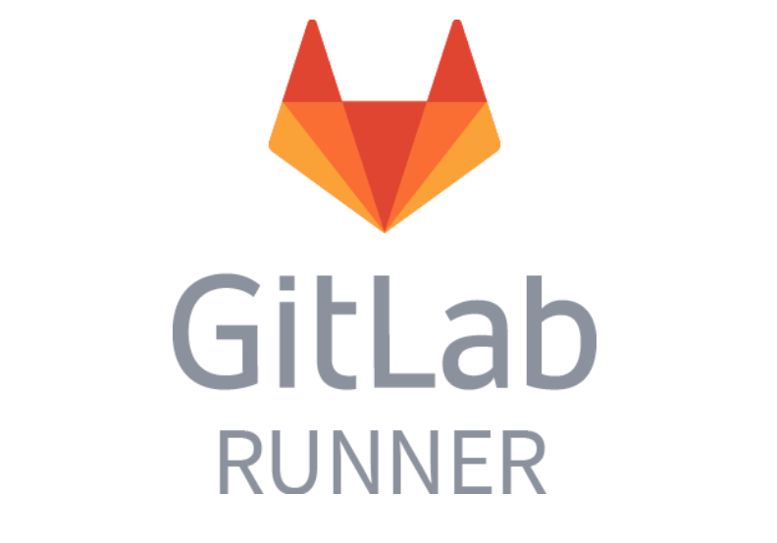
GitLab Runner Setup
Running Your Pipelines with Custom Executors

Slide 71
What is GitLab Runner?
GitLab Runner is an open-source application used to run CI/CD jobs in GitLab pipelines.
Purpose:
It’s the worker agent that executes jobs defined in your .gitlab-ci.yml file.
Key Points:
Can be installed on any platform (Linux, Windows, Mac, Docker)
Executes jobs either locally or in containers (Docker, Kubernetes)
Supports shared runners (global) and specific runners (project-level)
Architecture:
GitLab Server <-- triggers --> GitLab Runner <-- executes --> Your build/test/deploy scripts

Slide 72
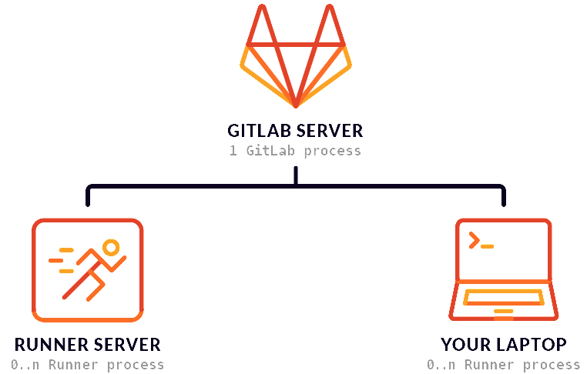
What is GitLab Runner?

Slide 73
Install GitLab Runner

Slide 74
Registering the Runner with a Project
Command to Register: gitlab-runner register
Interactive Setup Prompts:
GitLab URL: https://gitlab.com or your GitLab instance
Token: Found in GitLab → Settings → CI/CD → Runners
Description: e.g., ubuntu-runner-01
Tags: Optional labels for job selection
Executor: Choose from Shell, Docker, Kubernetes, etc.
Tip: Use different tags for specific runners and reference them in .gitlab-ci.yml
https://docs.gitlab.com/runner/register/

Slide 75
Runner Executor Types
Executor | Description | Use Case
Shell | Executes jobs in the shell of the host OS | Simple environments (VMs, servers)
Docker | Runs jobs inside Docker containers | Most flexible, clean environment
Docker+Machine | Auto-spins up Docker machines on demand | Scalable CI in the cloud
Kubernetes | Uses Kubernetes pods for job execution | Cloud-native CI/CD
Custom | Plug in your own logic or infrastructure | Advanced enterprise setups

Slide 76
Summary
GitLab Runner executes your .gitlab-ci.yml jobs
It can be installed on Linux, Windows, or as a Docker container
Runners must be registered with your GitLab project or group
Multiple executor types give flexibility depending on your infrastructure

Slide 77
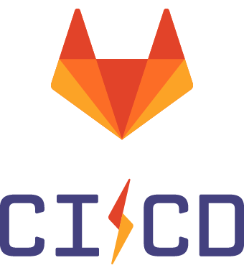
Advanced GitLab CI/CD
Secure, Performant, and Flexible Pipelines

Slide 78
Secrets and CI/CD Variables
What are CI/CD Variables?
Key-value pairs used to store configurable or sensitive data in your pipeline
Examples: API keys, deployment paths, Docker usernames/passwords
Types of Variables:
Type | Scope | Example
Project Variables | Per-project | PROD_DB_PASSWORD
Group Variables | Across projects | SLACK_WEBHOOK_URL
Masked & Protected | Secure | Values hidden in logs and restricted to protected branches

Slide 79
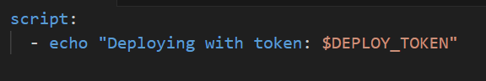
Cont.
How to use in .gitlab-ci.yml:
Best Practices:
Mark secrets as masked
Avoid hardcoding secrets into your YAML
Use protected variables for production-only branches

Slide 80
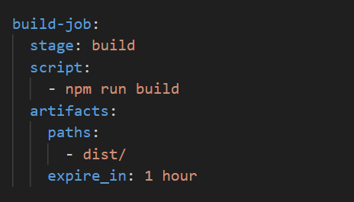
Artifacts and Caching
Artifacts
Files or directories saved after a job finishes
Used to pass results to later jobs (e.g., compiled code, test reports)

Slide 81
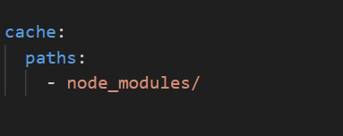
Artifacts and Caching Cont.
Caching
Speeds up jobs by reusing previously downloaded dependencies
Cache is shared between jobs/stages

Slide 82
Artifacts and Caching Cont.
Key Difference:
Feature | Purpose | Scope
Artifacts | Share files between jobs | Pipeline
Cache | Speed up repeated work | Runner-wide

Slide 83
Conditional Execution
Conditional execution allows you to control whether a job runs based on specific conditions such as:
The branch name
The type of pipeline (push, merge request, schedule)
The presence or value of a variable

Slide 84
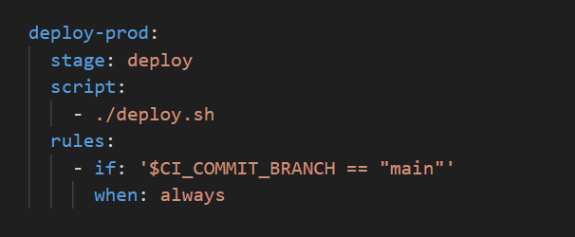
Conditional Execution Cont.
Recommended Method: rules
Use the rules: keyword to define when a job should run, be skipped, or require manual approval.
This job runs only when a commit is pushed to the main branch.

Slide 85
Conditional Execution Cont.
Common Conditions You Can Use
Condition | Description
$CI_COMMIT_BRANCH == "main" | Only run for a specific branch
$CI_COMMIT_TAG | Only run when a tag is pushed
$CI_PIPELINE_SOURCE == "schedule" | Run only for scheduled pipelines
$MY_CUSTOM_VAR == "true" | Run based on custom variable value

Slide 86
Conditional Execution Cont.
Best Practices:
Prefer rules: over the old only: / except:
Use manual jobs for sensitive steps (like production deployment)
Combine multiple conditions using multiple rules

Slide 87
Matrix Builds & Parallel Jobs
A Matrix Build runs the same job multiple times with different sets of variables.
This is useful for:
Testing your app on multiple environments (e.g., OS, Node versions)
Avoiding copy-pasting multiple jobs for each combination

Slide 88
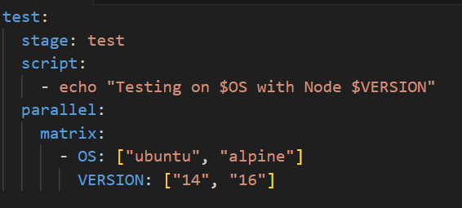
Matrix Builds & Parallel Jobs Cont.
Example: Matrix Build for OS and Node Versions
Result: This will create 4 jobs:
ubuntu + node14
ubuntu + node16
alpine + node14
alpine + node16
Each job runs in parallel, with its own OS and Node version combination.

Slide 89
Matrix Builds & Parallel Jobs Cont.
Parallel jobs let you split a single job into multiple identical instances to save time.
Use it for:
Splitting long-running tests across multiple runners
Load testing
Processing data chunks

Slide 90
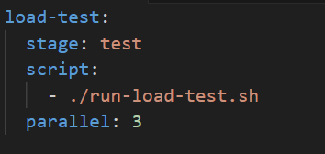
Matrix Builds & Parallel Jobs Cont.
Example: Run the same job 3 times in parallel
Result:
Three identical jobs will run at the same time, each independently executing the same script.

Slide 91
Matrix vs Parallel – Key Difference
Feature | Matrix Build | Parallel Job
Purpose | Run job with different variables | Run same job multiple times
Custom logic | Yes – values change per job | No – logic is identical
Use case | Test multiple OS/language versions | Speed up job or simulate load
Use matrix builds for environment/version testing
Use parallel jobs to speed up test execution
Combine both for advanced CI/CD pipelines

Slide 92
Summary
Use CI/CD variables for secrets and environment configuration
Artifacts transfer files between jobs; caching accelerates builds
Use rules for conditional execution of jobs
Matrix and parallel jobs help you test faster across many configs

Slide 93


Slide 94
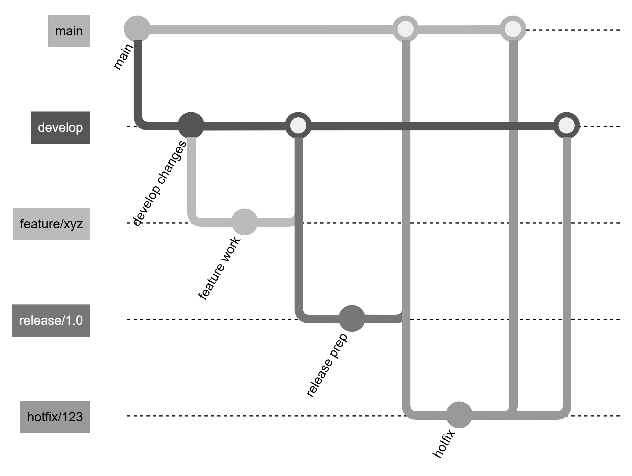
What is GitFlow?
GitFlow is a multi-branch model with strict separation of development stages.
Core branches:
main (production-ready code)
develop (integration branch)
feature/*
release/*
hotfix/*
Notes:
GitFlow works best for products with scheduled releases, not fast-moving microservices. Many teams are simplifying away from GitFlow.

Slide 95
GitFlow
Strengths
Highly structured
Good for large applications
Clear separation between development & release preparation
Weaknesses
Too many long-lived branches
Slower cycle time
Overkill for teams practicing continuous delivery
Merge churn increases complexity in CI/CD

Slide 96
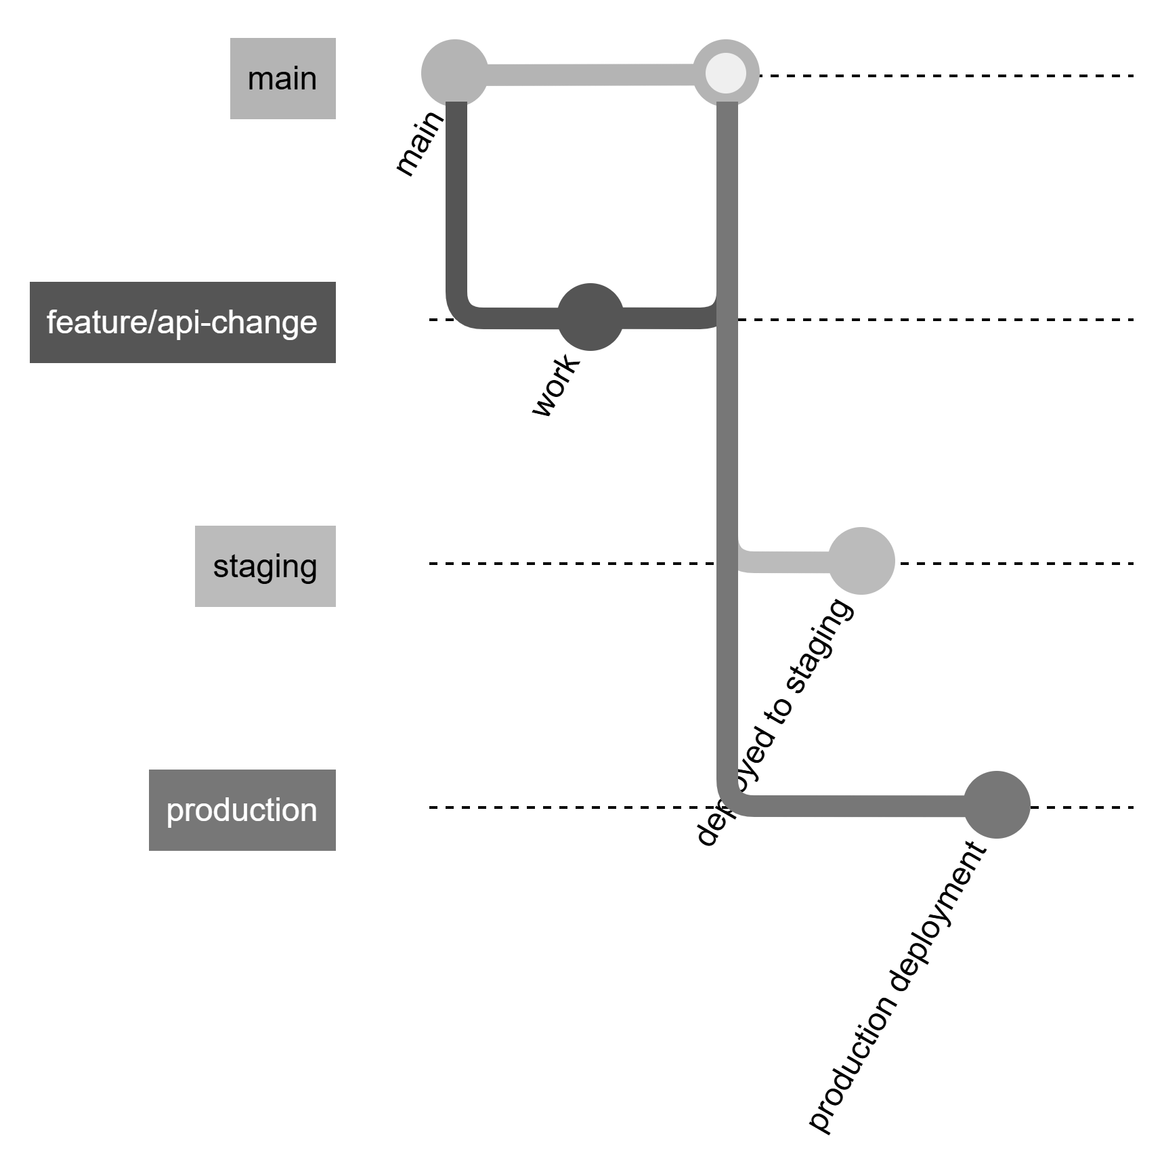
What is GitLab Flow?
GitLab Flow is a simpler, more modern approach combining feature branches + environment branches.
Core Model
main = source of truth
feature/* → merge via MR
Optional branches per environment:
production
staging
pre-production
Notes:
GitLab Flow aligns perfectly with automated deployment pipelines. Every merge to main can trigger tests, container builds, and deployments.

Slide 97
GitLab Flow
Strengths
Simple branching → fewer merges
Works perfectly with GitLab CI/CD
Faster delivery cycle
Clear mapping between branches & environments
Ideal for cloud-native & containerized .NET apps
Weaknesses
Requires disciplined MR usage
Less suited for heavily manual release processes

Slide 98
GitFlow vs GitLab Flow
Criteria | GitFlow | GitLab Flow
Complexity | High (many branches) | Low (simple model)
Release Model | Suited for scheduled releases | Suited for continuous delivery
CI/CD Fit | Requires extra automation | Designed for GitLab CI/CD
Team Size | Large teams with heavy processes | Any size, especially agile teams
Branch Lifetime | Long-lived branches | Mostly short-lived feature branches
Hotfix Handling | Dedicated hotfix branch | Easy: branch from main
Suitable For .NET monoliths? | Yes | Yes
Suitable For microservices? | No | Best choice
Notes:
GitFlow = good for teams that must manage complex release trains (banks, insurance). GitLab Flow = best for modern DevOps teams using GitLab pipelines.

Slide 99
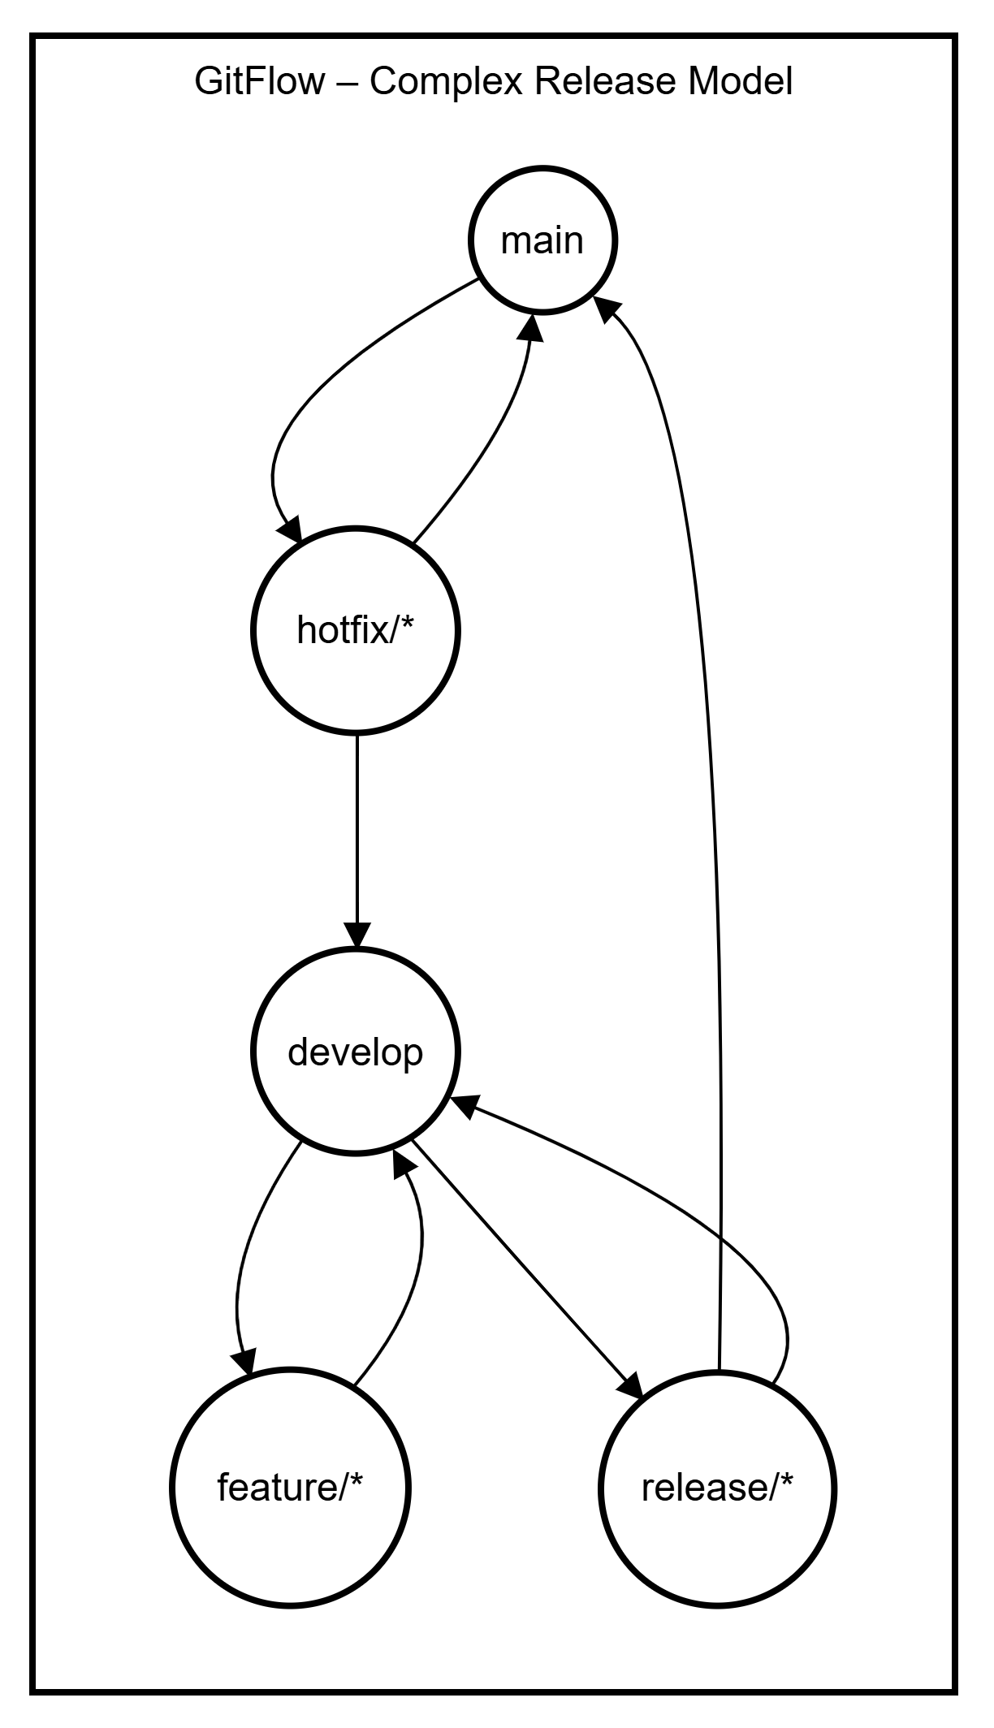
GitFlow
GitFlow separates all stages of development into distinct branches:
main → always production-ready
develop → integration branch where features are combined
feature/* → short-lived branches per feature
release/* → stabilization before production
hotfix/* → urgent production fixes
Notes:
Developers branch off develop to create feature branches.
Completed features merge back into develop (NOT main).
When preparing a release, a release branch is created from develop.
Release is tested, refined, then merged into:
main (production)
develop (to sync fixes)
If a production bug exists, a hotfix branch is created from main, then merged to both main & develop.

Slide 100
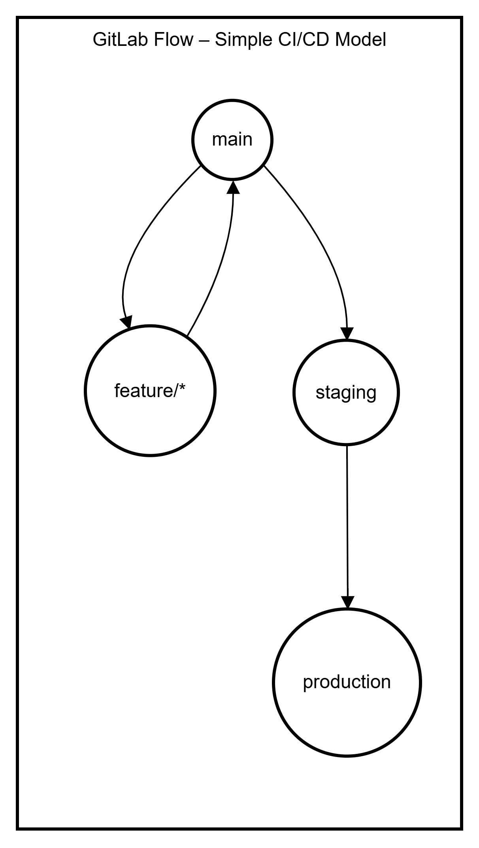
GitLab Flow
GitLab Flow streamlines the branching model to reflect modern DevOps practices:
main → single source of truth
feature/* → short-lived work branches
Optional environment branches (e.g., staging, production)
Notes:
How the flow works
Developers create feature branches directly from main.
Feature → Merge Request (MR) → reviewed & merged into main.
GitLab CI/CD runs automatically on main.
Deployments are managed through environment branches:
main → staging → production
Deployments are automated or triggered through MR approvals.

Slide 101
What TFS Check-In Policies Used to Do
Enforced rules before allowing check-in:
Work item required
Code comment required
Tests must pass
Code analysis must run
Review required (optional)
Policies were client-side rules inside Visual Studio

Slide 102
What GitLab Does Instead
GitLab replaces check-in policies with Merge Request (MR) Templates + CI + Branch Protections
MR Templates define what every developer must include before merging:
Linked issue
Description of change
Test evidence
Architecture/security notes
Impact analysis
Checklist for reviewers
Notes:
TFS enforced rules before check-in; GitLab enforces rules during merge request.
In GitLab, governance happens server-side — more consistent and secure.
MR Templates ensure that every merge includes traceability and quality gates.
CI replaces static check-in rules with automated validation: tests, code scanning, linting.
Developers no longer bypass policies accidentally because everything is centralized in GitLab.

Slide 103
Cont.
Branch protection rules enforce:
Who can merge
Required approvals
CI pipeline must pass
No direct pushes to protected branches (like main)
Result: Same governance as TFS, but more flexible and automated.

Slide 104
Example MR Template (GitLab)
## Summary
Describe the purpose of this change
## Linked Issue
Closes #ISSUE_ID
## Changes
- What was changed?
- Why was it needed?
## Testing
- [ ] Unit tests added/updated
- [ ] Manual testing done
- [ ] CI pipeline passed
## Impact
- Does this change affect other services?
- Breaking changes?
## Checklist
- [ ] Code reviewed
- [ ] Code follows conventions
- [ ] Security considerations addressed

Slide 105
SonarQube
SonarQube is an automated code quality and security platform that analyzes source code to find:
Bugs
Security vulnerabilities (SAST)
Code smells (bad practices)
Duplicate code
Maintainability issues
Test coverage gaps
It acts as a “quality gate” in your CI/CD pipeline meaning code cannot be merged unless it meets required standards.
SonarQube = Automated code reviewer + security scanner + quality gate.

Slide 106
What SonarQube Checks in a .NET Project
SonarQube automatically scans:
C# code quality & styling
Security vulnerabilities (SAST)
Code smells
Duplications
Unit test coverage
Roslyn analyzer results
Cyclomatic complexity
Deprecated API usage
For .NET Teams:
SonarQube integrates fully with:
dotnet build
dotnet test
.csproj file metadata
GitLab Merge Requests

Slide 107
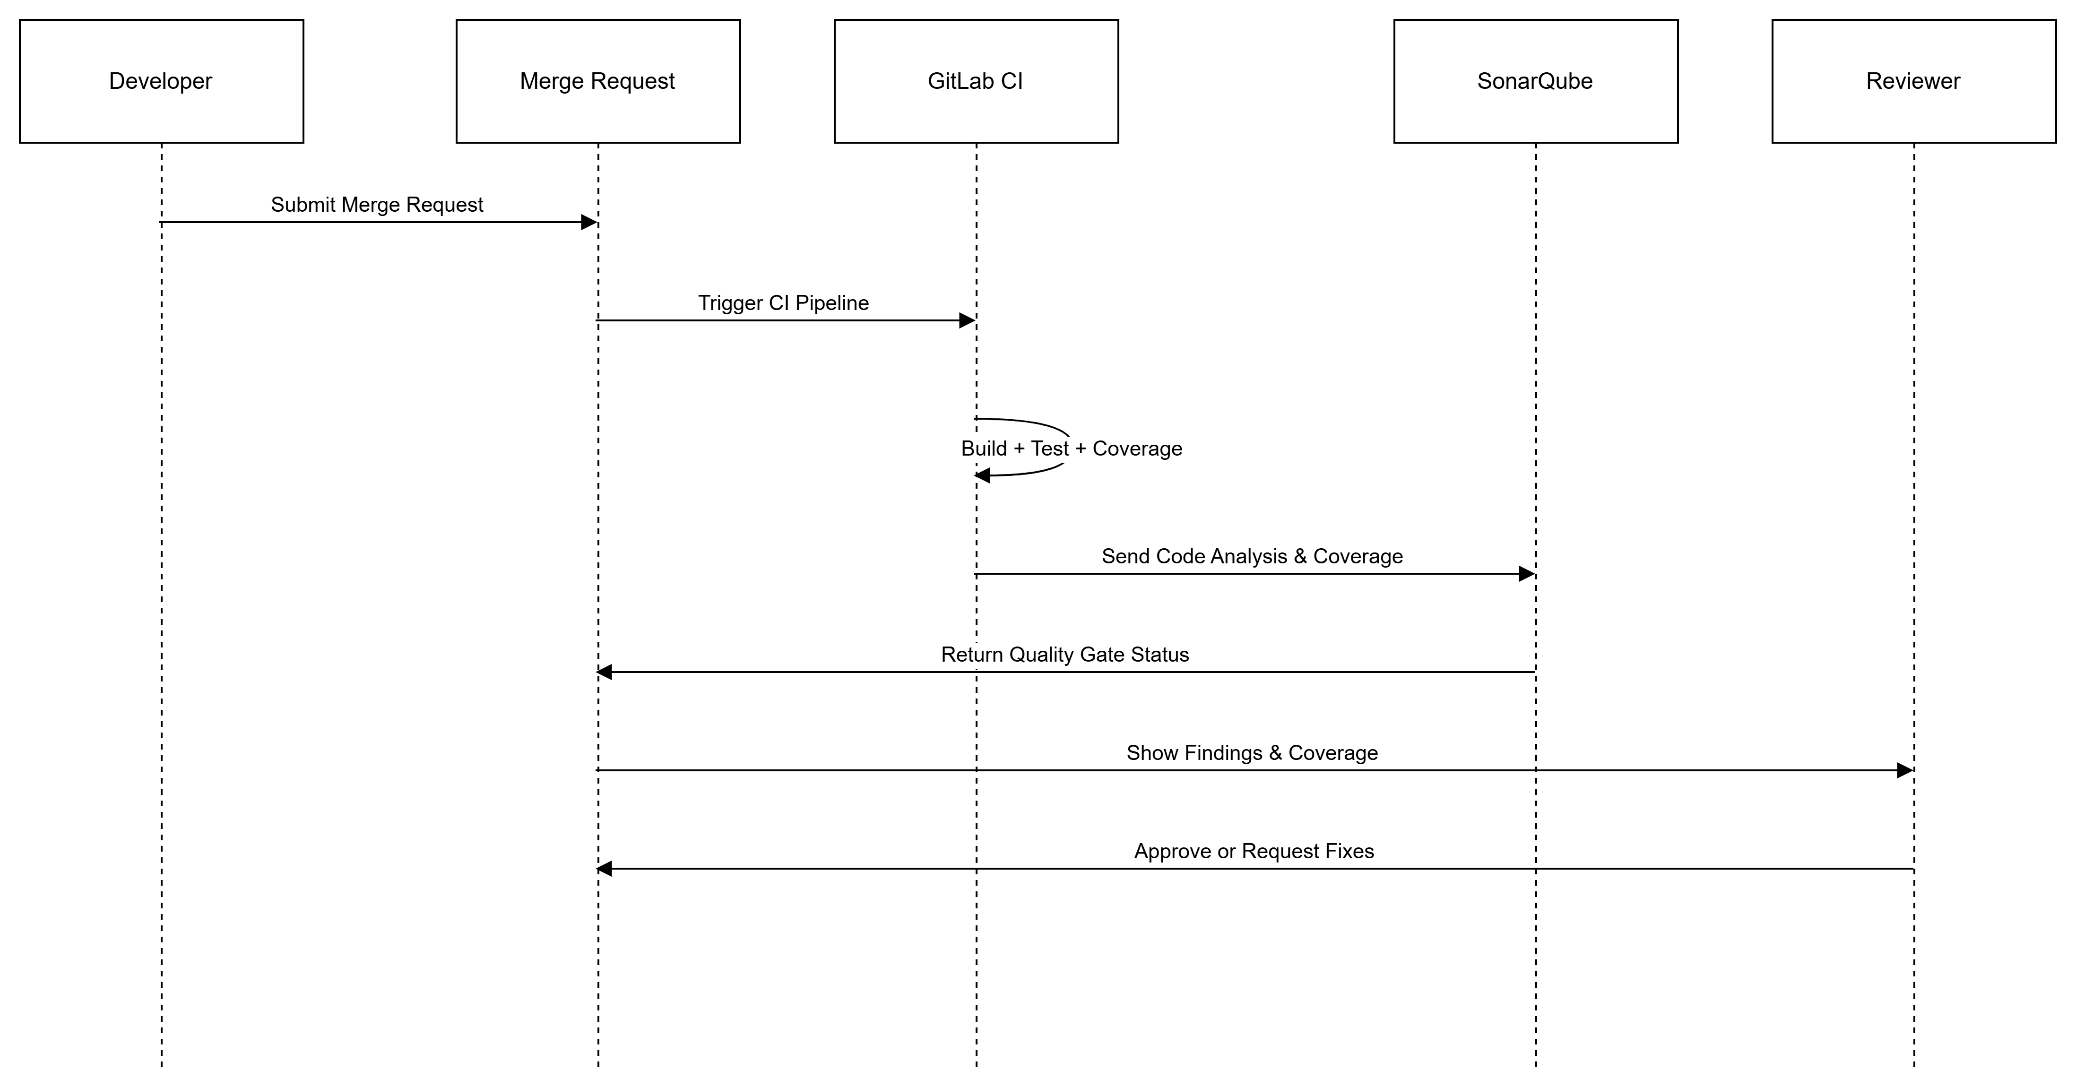

Slide 108
GitLab UI: What Developers See in Merge Requests
Developers see:
SonarQube summary directly in MR
Coverage % for changed files
New bugs, vulnerabilities, or code smells
Line-by-line annotations in MR diffs
“Quality Gate Passed” or “Failed” badge
Outcome
Issues are caught early
Code reviewers get better context
Safer and more stable deployments

Slide 109


